Slide 1
Image Compression using Huffman Coding Algorithm
PROJECT TITLE:
Submitted by:
Group-14
Bodhisattwa Talukder (21051805)
Subandhu (21051851)

Slide 2
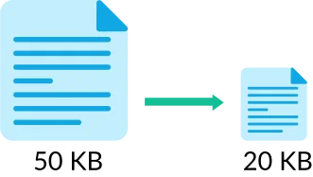
Image Compression
Image compression is a process of reducing the size of an image file while preserving its visual quality to a certain extent. This reduction in size is achieved by eliminating redundancy and irrelevant information in the image data.
There are two main types of image compression: lossless and lossy.
Lossless Compression: In lossless compression, the original image can be perfectly reconstructed from the compressed version without any loss of information.
Lossy Compression: Lossy compression achieves higher compression ratios by sacrificing some details in the image.

Slide 3
Objective
Understanding Huffman Coding:
Gain a deep understanding of the Huffman Coding algorithm and its application to image compression. Explore how the algorithm assigns variable-length codes to different symbols (in this case, pixel values) based on their frequencies in the image.
Lossless Compression:
Implement Huffman Coding as a lossless compression technique to ensure that the original image can be perfectly reconstructed from the compressed version. Preserve important details and ensure no loss of information during the compression and decompression processes.
Practical Application:
Demonstrate the practical application of Huffman Coding in real-world scenarios. Showcase the benefits of using this algorithm for image compression, emphasizing its suitability for scenarios where maintaining the highest quality is essential.

Slide 4
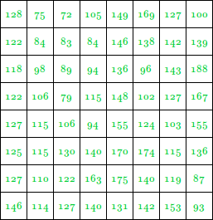
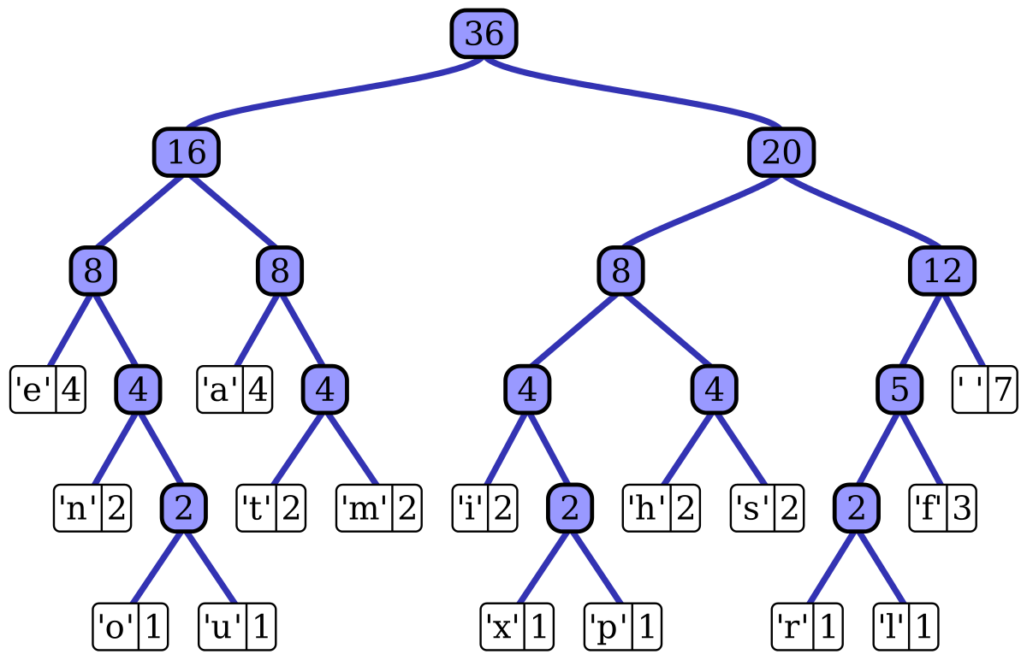

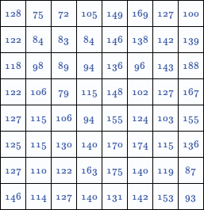
How Huffman coding algorithm works?

Slide 5
Why Huffman Coding for image compression?
Variable-Length Coding:
Huffman Coding assigns shorter codes to more frequently occurring symbols and longer codes to less frequent ones. In the context of image compression, this means that commonly encountered pixel values (symbols) are represented with shorter codes, leading to more efficient compression.
Redundant Information:
Huffman Coding eliminates redundant information in the image data, reducing the overall file size without sacrificing essential details. Redundancy often occurs in images due to patterns, and Huffman Coding efficiently captures and represents this information.
Simple Implementation:
The basic concept of Huffman Coding is relatively simple to understand and implement. This makes it an attractive choice for educational purposes and practical implementation, such as in coding assignments or projects for a lab setting.

Slide 6
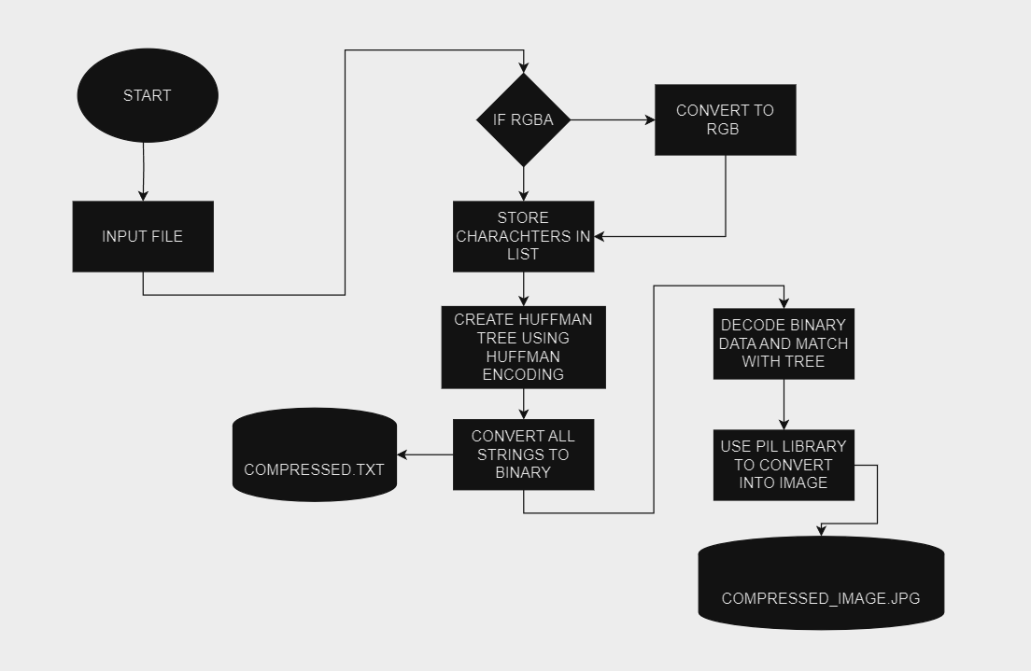
Project Architecture/Workflow:

Slide 7
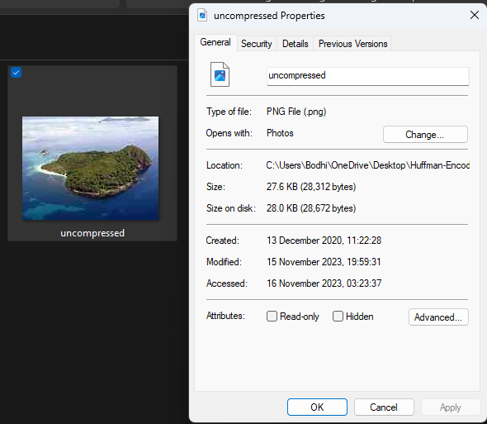
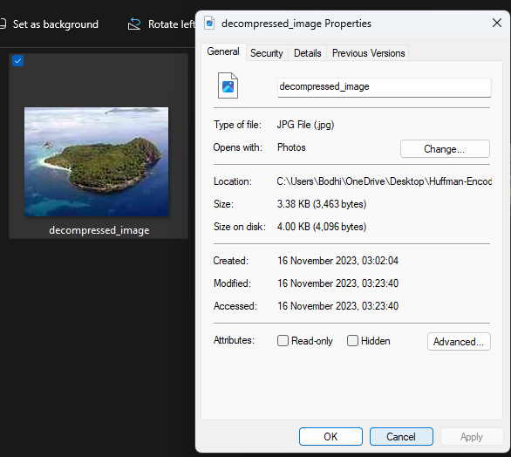
Input & Output
INPUT
OUTPUT

Slide 8
Challenges Faced
Coding the algorithm for the project in C
Use of JPG/JPEG file formats instead of PNG
Conversion of RGBA color schemes in PNG files

Slide 9
Conclusion
In summary, our project on "Image Compression using Huffman Coding" demonstrated the effectiveness of the algorithm in significantly reducing image file sizes while preserving visual quality. Despite challenges, our strategic solutions underscore the adaptability and efficiency of Huffman Coding. Looking ahead, potential research directions include exploring hybrid compression methods and optimizing the algorithm for specific image types. This project not only showcases the practical application of Huffman Coding but also lays the groundwork for future advancements in image compression.

Slide 10
References
https://www.geeksforgeeks.org/image-compression-using-huffman-coding/
https://stackoverflow.com/questions/71094679/how-to-convert-rgba-bytes-to-png-image

Slide 11
Thank you!

